Slide 1
Programa Binacional de Educación Migrante
México - Estados Unidos
Intercambio de Maestros 2002
SUMMER CAMP
Crescent City, Florida
12 de julio de 2002 July 12, 2002
Binational Migrant Education Program
Mexico - United States of America
Teachers Exchange 2002

Slide 2
Secretaría de Relaciones Exteriores
Consulado de México en Orlando
Comunidades Mexicanas en el Exterior
Secretaría de Educación Jalisco
Grupo Cultural Huitzilin
Migrant Education Center
Catholic Charities\Farm Workers Ministry
Middleton Burney Elementary School

Slide 3
Diseñado y elaborado por:
Profr. José Luis Gómez Gutiérrez (Jalisco)
Centro de Actualización del Magisterio
Profr. Norma Patricia Quijas Martínez (Jalisco)
Centro de Bachillerato Tecnológico Industrial y de Servicios
Profr. David Penaflor Valdez (Morelos)
Director del grupo cultural “Huitzilin”

Slide 4
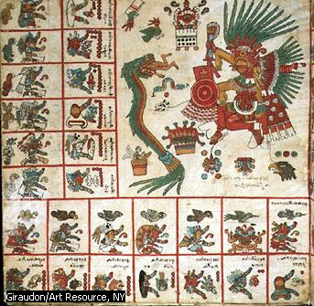
Mexico Foundation: AN EAGLE ON A NOPAL
The city of Mexico was built upon a lake. This is the story of why the Aztecs built their most beautiful city in such a stange place.
The most powerful god of the Aztecs was Huitzilopochtli, the god of war.
    El Códice Borbónico azteca muestra a los dioses Tezcatlipoca y Quetzalcóatl, éste en forma de serpiente verde que devora a un hombre. La ilustración muestra la importancia del sacrificio humano en la religión azteca, así como la leyenda de que Quetzalcóatl, el dios desterrado por Tezcatlipoca, volvería para dirigir a los aztecas.
    Giraudon/Art Resource, NY

Slide 5
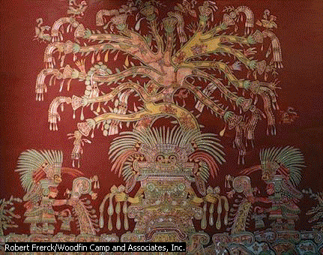
Mexico Foundation
He was so powerful that Tlaloc, the rain god, would obey him.
For the Aztecs believed that Huitzilopochtli sent the lightning to kill their enemies. In the long ago, the Aztecs went to place to place. Wherever they stayed, they built a temple for their war god. In the temple the Aztec priests put the stone statue of Huitzilopochtli.
The priests prayed to the statue to tell them what to do. And always the priests told the people.
    El dios azteca Tláloc aparece en esta ilustración en todo su esplendor: coronado de plumas de garza y esparciendo semillas de maíz y frijol que después su lluvia hará germinar.
    Este fresco El dios de la lluvia se encuentra en el Museo Nacional de Antrop ogía de la ciudad de México.
    Robert Frerck/Woodfin Camp and Associates, Inc.

Slide 6
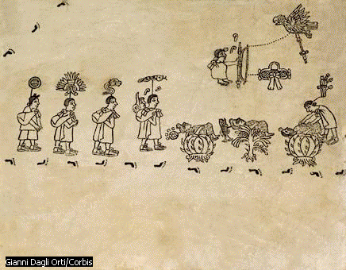
Mexico Foundation
“The war god tells us to go to the South.”
Then the Aztecs would take the statue of their war god and go to the South. They crossed rivers and they climbed mountains. Sometimes they found a beautiful place. The people would build a temple and some houses.
The people would say to the priests:
    La imagen reproduce una lámina del Códice Boturini que hace referencia a la migración de los aztecas. Dicho Códice se encuentra en el Museo Nacional de Antropología, en la ciudad de México.
    Gianni Dagli Orti/Corbis

Slide 7
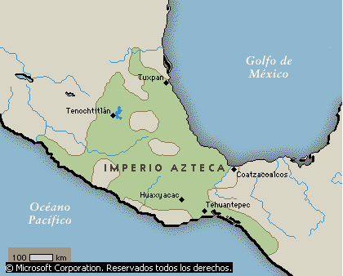
Mexico Foundation
“Go to the temple and pray to our powerful war god. Ask Huitzilopochtli if we are to build our beautiful city here.”
But the priests would say: “The war god tells us to go to the South. He tells us to build the city where a cactus grows out of a rock.”
The Aztecs always did what the priests of the war god told them to do. They marched to the South.
    Según una leyenda, los aztecas fundarían una gran ciudad allí donde encontraran un águila devorando a una serpiente posada sobre un nopal. En el año 1325, los sacerdotes aztecas descubrieron esta escena en un islote cerca del lago Texcoco, y allí erigieron la ciudad llamada Tenochtitlán. En el momento de su más alto desarrollo, el Imperio azteca se extendió por lo que hoy es la región central del país, desde la costa del golfo de México hasta la del Pacífico, y desde el Bajío hasta Oaxaca (Huaxyacac).
    © Microsoft Corporation. Reservados todos los derechos.

Slide 8
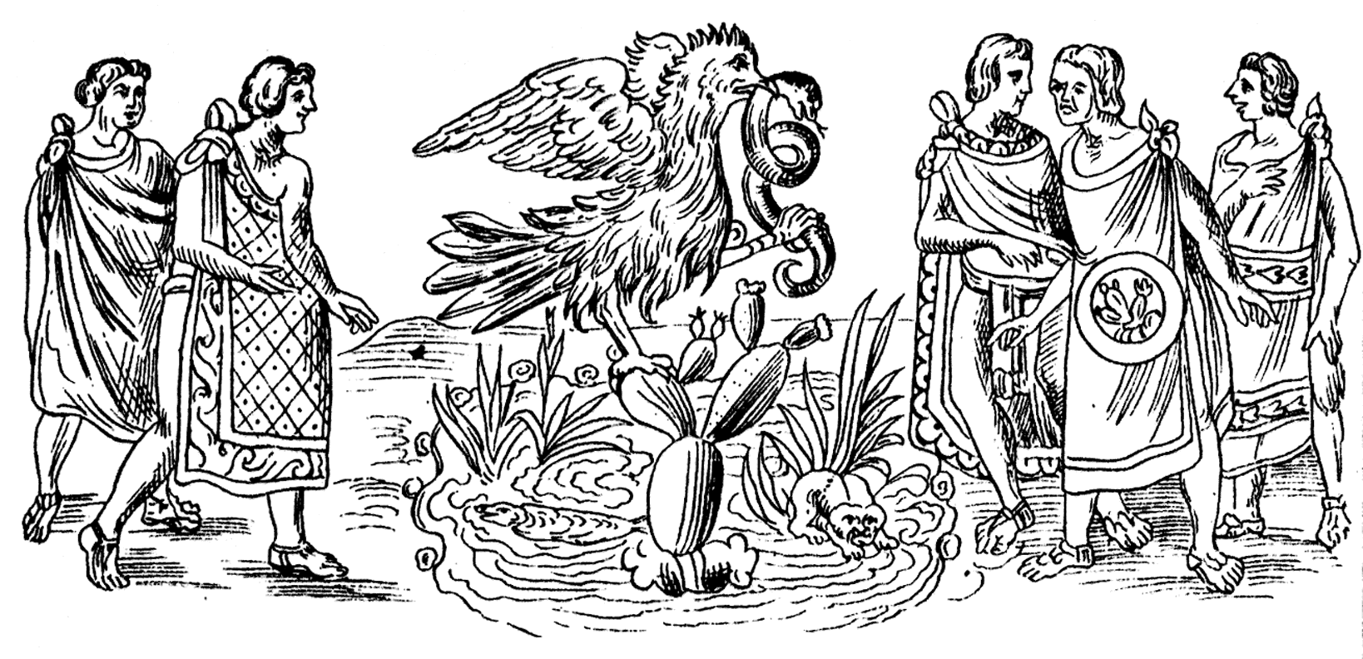
Mexico Foundation: CODICE DURAN
One evening just as the sun was going down, the Aztecs came to a beautiful lake. They saw something very strange out in the lake.
There was a large rock on an island in the lake. Right out of the rock a cactus plant and an eagle holding a snake in its claws. And the setting sun made the rock, cactus plant, the eagle and the snake look like gold.

Slide 9

Mexico Foundation
Look! Look! Look! Cried the priests of Huitzilopochtli. “The war god has shown us the place where we are to build our beautiful city.”
“But how can we build a city on a little island in a lake?” cried the people.
The priests said, “Huitzilopochtli is strong like the eagle . Huitzilopochtli is wise like the snake.

Slide 10
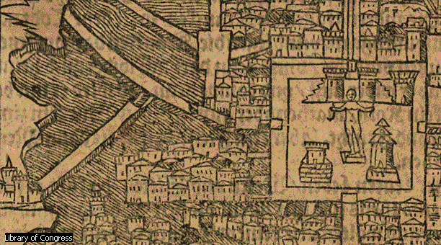
Mexico Foundation
He will tell us how to build our city.”
The Aztecs began to build their beautiful city. They made the island bigger and bigger. They built a great high temple to their war god. They also built smaller temples to all the other gods, beautiful palaces, roads of stone and bridges from their beautiful island to the shores of the lake.
But most wonderful of all, they built gardens on the lake.
    La ciudad de México fue originariamente la capital del Imperio azteca, Tenochtitlán, fundada en 1325. Tenía más de 200.000 habitantes cuando los conquistadores españoles llegaron allí a principios del siglo XVI. El mapa muestra los puentes y diques que cruzaban en lago Texcoco para conectar la ciudad con tierra firme.

Slide 11
Mexico Foundation
Flowers and vegetables and even trees were grown in the dirt upon the rafts in the lake.
The Aztec city on the island in the lake became the most beautiful city in Mexico.
The king of the Aztecs became the most powerful ruler in Mexico.

Slide 12
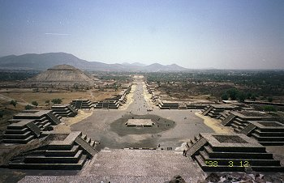
Mexico City
Plaza of the Moon and Avenue of the Dead. View from the Pyramid of the Moon.
The size of the Pyramid of the Moon is 140mx150m at the base, 45.8m height. A.D.100-350.
Pyramid of the Sun is middle of left side.

Slide 13
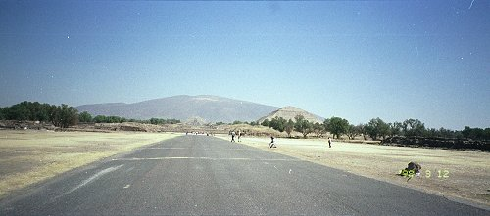
View from the end of the Avenue of the Dead.

Slide 14
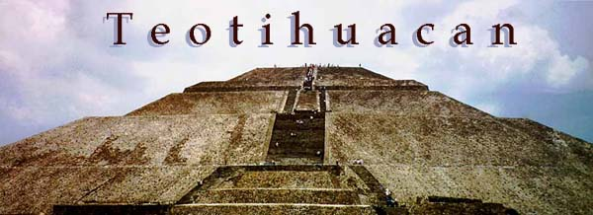
Sun Pyramid

Slide 15
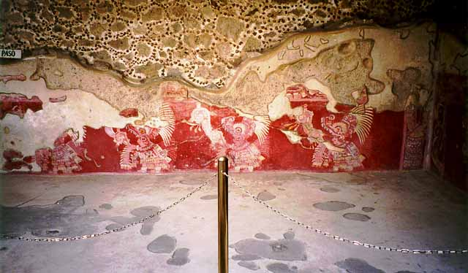
Tepantitla Prehispanic Paints

Slide 16
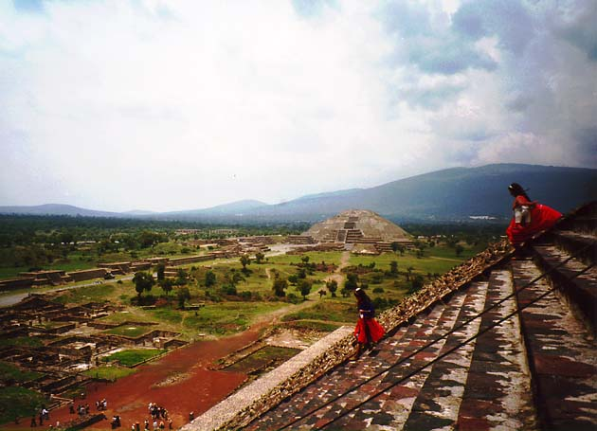
Sightseeing from Moon Pyramid

Slide 17
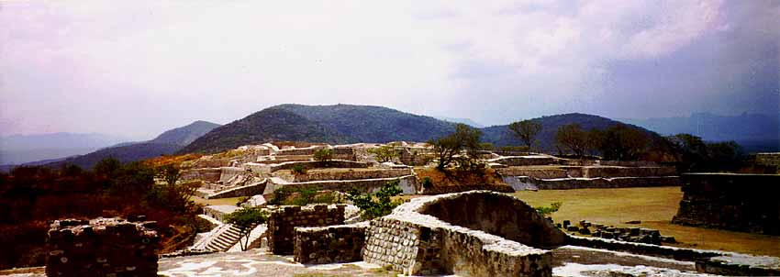
Xochicalco, Morelos. Mexico National Park
Elite residences

Slide 18
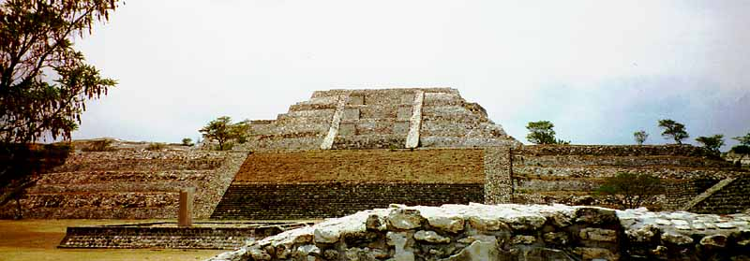
The Grand Pyramid, with the "stela of two glyphs"

Slide 19
Esto es un ejemplo de lo que somos y a lo que pertenecemos, de la riqueza cultural que tenemos y de lo que podemos ser, si lo intentamos con todas nuestras fuerzas.
Por eso, Hemos sido llamados:
La raza de bronce
This is an example from what we are and we belong, from our cultural heritage and what we can become, if we try really hard.
That’s why, we have been called:
The bronze race.

Slide 20
MEXICAN DRAWER
CODICE
PICTURE
CODE
OUR MEXICAN-NAHUATL LENGUAGE
CODICE

